Slide 1

Technical Presentation

Slide 2
Agenda
Overview of Technical Tasks
Development Stages
Demo

Slide 3
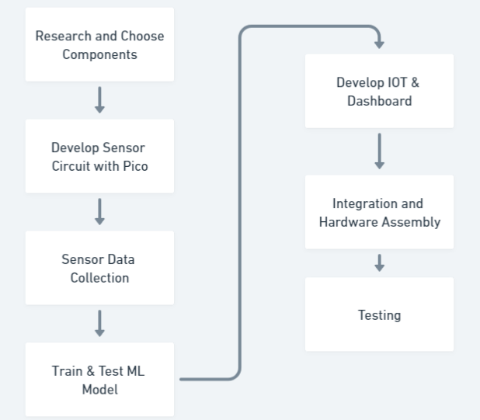
Overview of Technical Tasks

Slide 4
Development Stages
Phase 1 | Circuit Design & Data Collection
Phase 2 | Implementing Sleep and Wake-on-Interrupt
Phase 3 | ML Model Training & Testing
Phase 4 | Deployment Module

Slide 5
Phase 1 | Circuit Design & Data Collection
Sensor Circuit:
MPU6050
Microcontroller & Data Storage:
Pico & Emulated-EEPROM
Pico with Adalogger & SD Card
Data Collection
Data Flow in Software

Slide 6
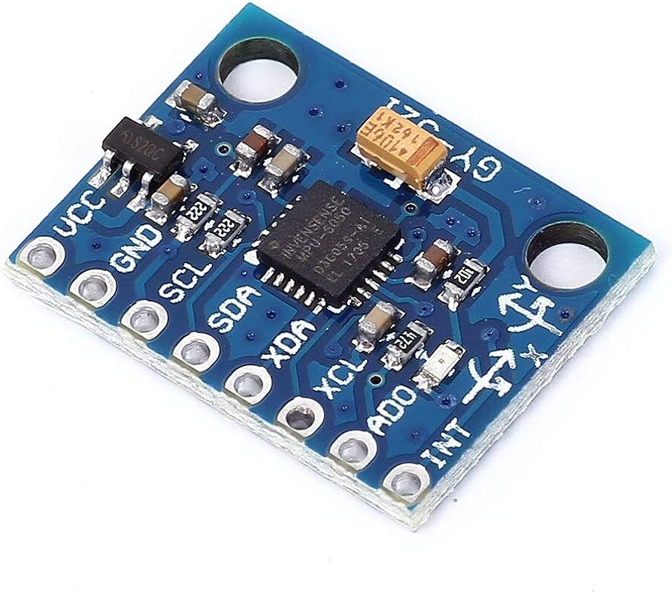
Phase 1 | Sensor Circuit
MPU6050 IMU
Advantages:
Low Cost
Low Power Consumtion
Interrupt on Significant Motion

Slide 7
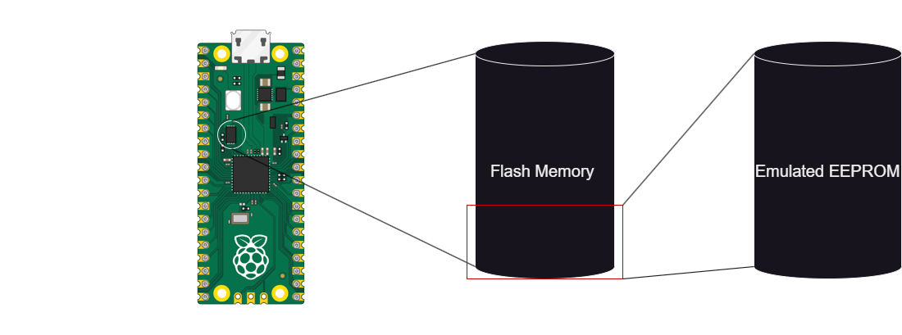
Phase 1 | Microcontroller & Data Storage
Pico & Emulated-EEPROM
Blocker:
EEPROM Capacity: Limited to only 4KB
Flash Memory: 2MB, also lacks a dedicated EEPROM
Write Limitations: Restricted number of writes affecting continuous data collection

Slide 8
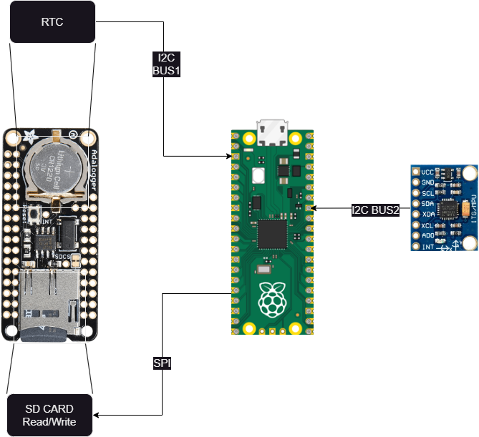
Phase 1 | Microcontroller & Data Storage
Pico & Adalogger
I2C Bus 1: Real-Time Clock Data
I2C Bus 2: Accelerometer sensor
Write both data to SD Card via SPI
Accelerometer ODR: 100Hz
Gathering data from accelerometer and RTC and writing to SD card.

Slide 9
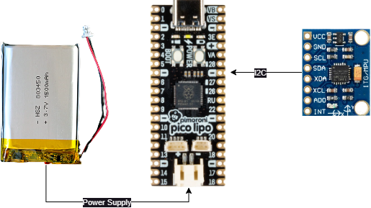
Phase 1 | Power Management
Lipo Pico & Flash Memory
Advantageous:
Battery Powered
High Storage Capacity: Stores approx. 1.33 million acc data cycles (~3.7 hours of continuous data at an ODR of 100Hz).
Fast Write Time: Less than 10ms, preventing data loss and increasing efficiency.

Slide 10
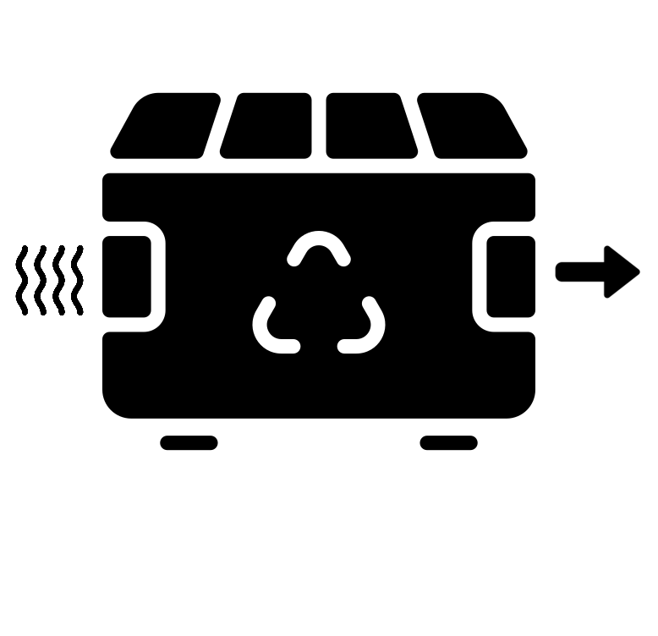



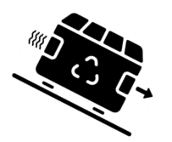
Phase 1 | Data Collection
Linear
Still
Ramp Up
Ramp Down
Required Trajectory

Slide 11
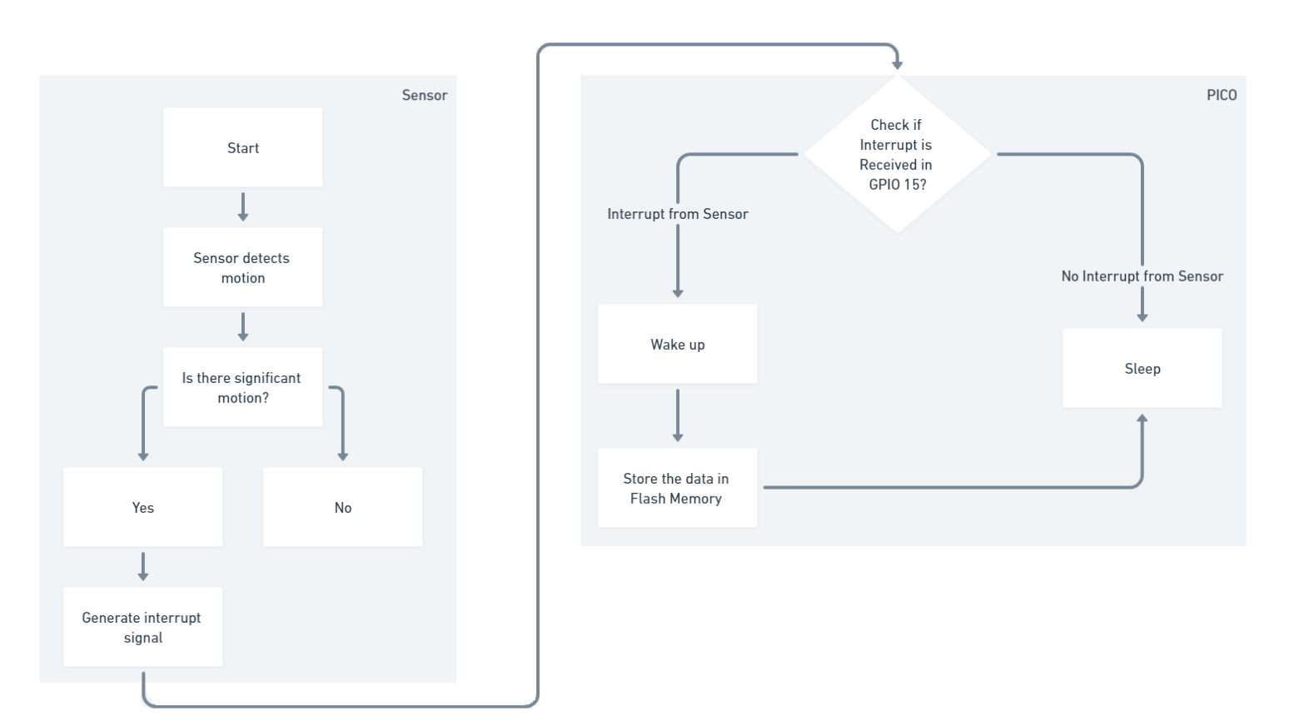
Phase 1 | Data Flow in Software

Slide 12
Phase 2 | Implementing Sleep and Wake-on-Interrupt
Earl‘s Arduino Core did not natively support Sleep Functionality
A new Arduino core was built on top of Earls core including the Sleep functionality from Raspberry Pico SDK
This enabled us to use the function sleep_goto_dormant_until which put pico to sleep until there is an interrupt in the particular GPIO pin.

Slide 13
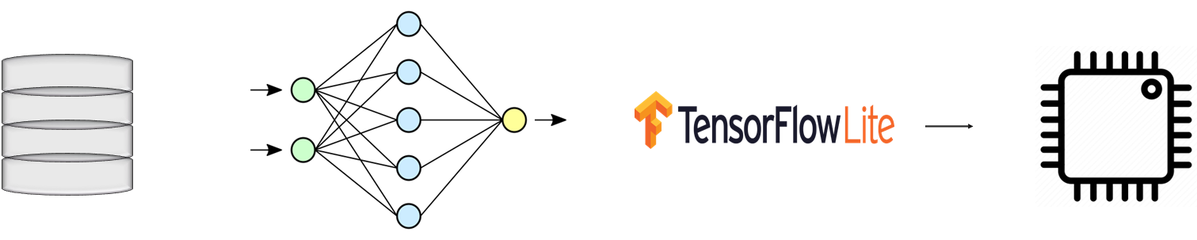
Phase 3 | ML Model Training & Testing
Garbage empty process recognition using Tiny ML
Data Acquisition & Preprocessing
Feature Extraction
ML Model Development
Model Testing & Regularization
TinyML Model Deployment

Slide 14
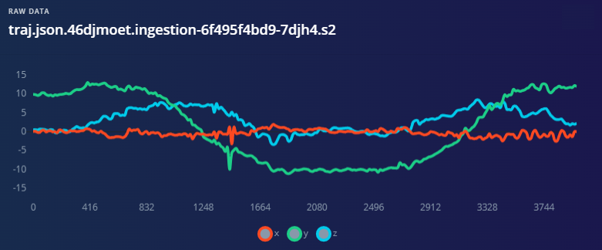
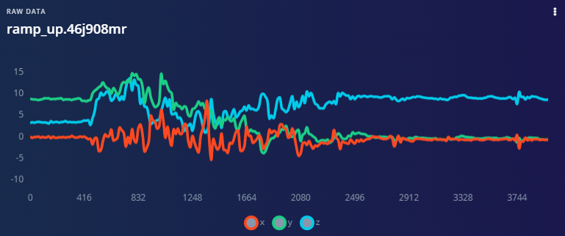
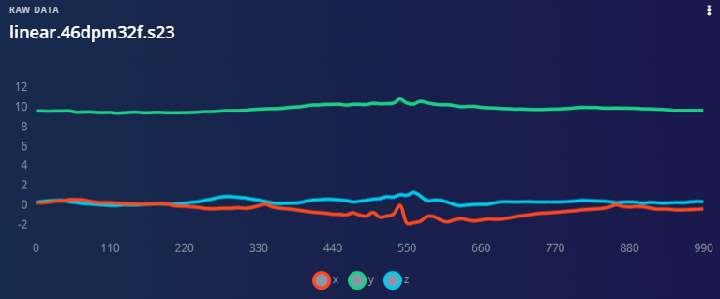
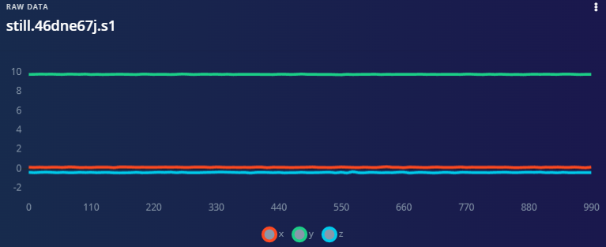
Phase 3 | ML Model Training & Testing
Data Collection and Cleaning

Slide 15
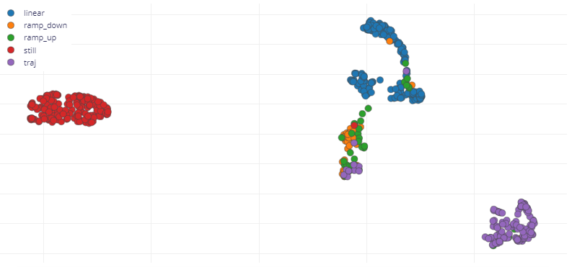
Phase 3 | ML Model Training & Testing
Feature Extraction for Classification

Slide 16
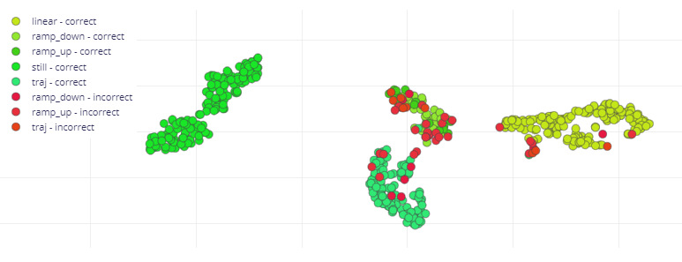
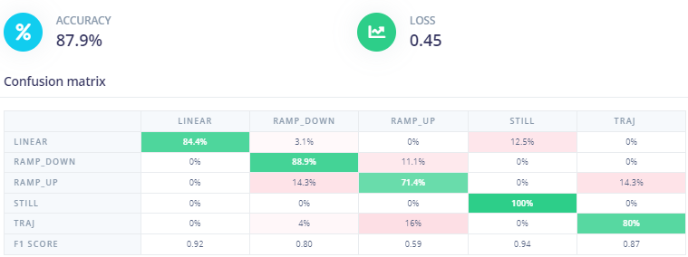
Phase 3 | ML Model Training & Testing
Classification
Accuracy

Slide 17
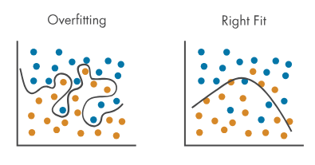
Phase 3 | ML Model Regularization

Slide 18
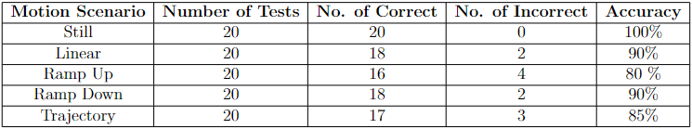
Phase 3 | ML Model Training & Testing
Test Results:

Slide 19
Phase 4 | Deployment
Integrate TinyML Model with Sleep Functionality & NodeMCU
IoT Dashboard
Software Flowchart
Enclosure and Mounting

Slide 20
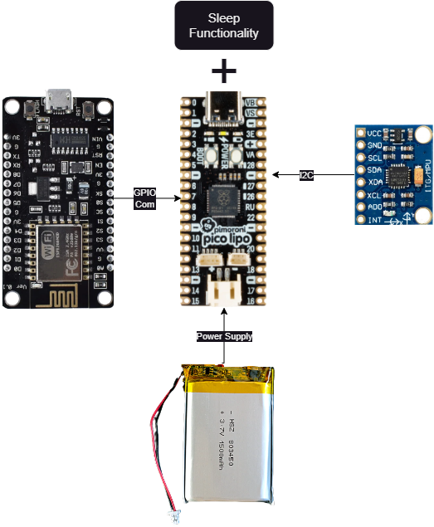
Integrate TinyML Model with Sleep Functionality & NodeMCU
Hardware Setup:

Slide 21
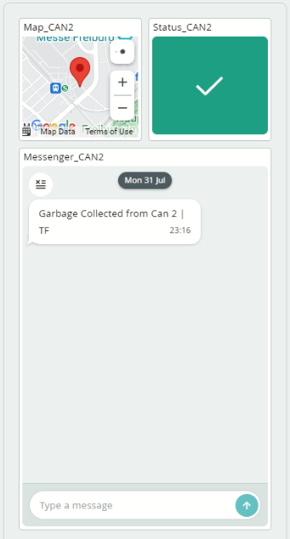
Phase 4 | IoT Dashboard
Arduino Cloud IoT

Slide 22
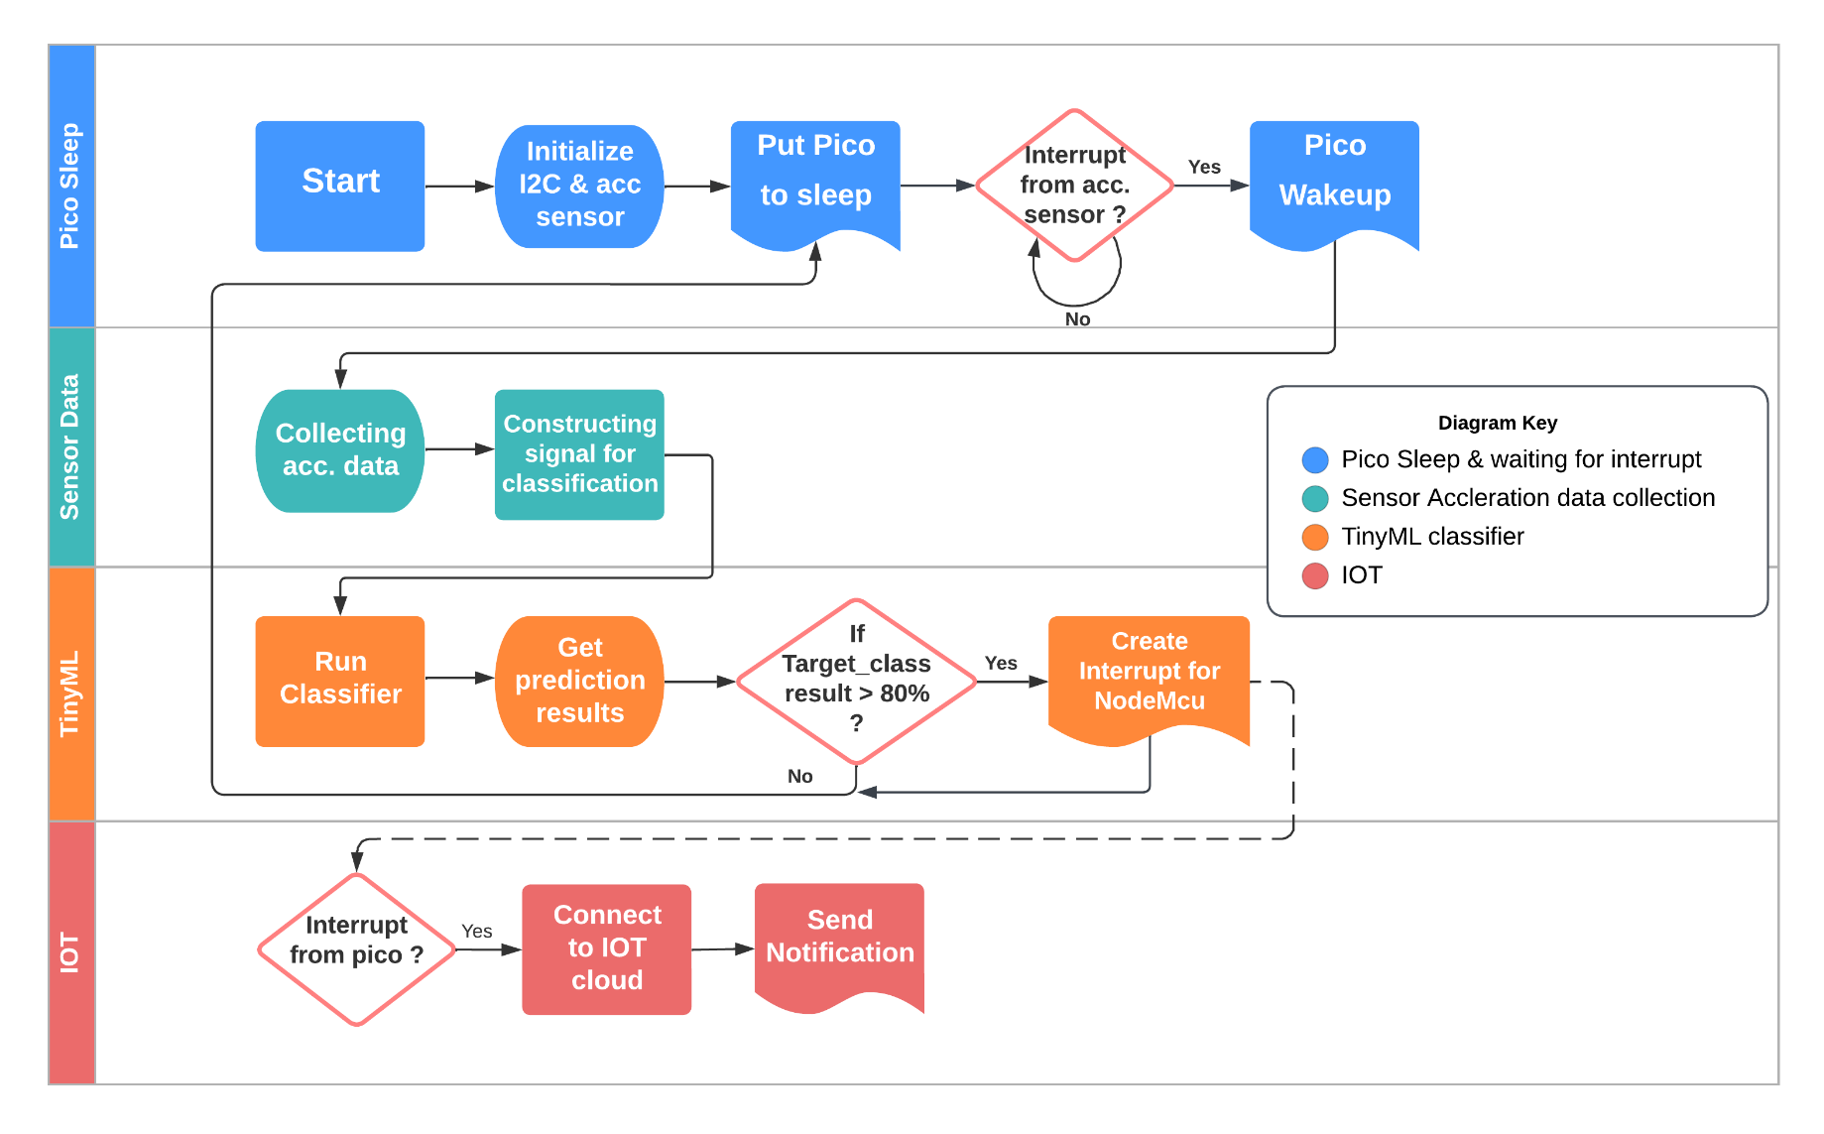
Phase 4 | Software Flowchart

Slide 23
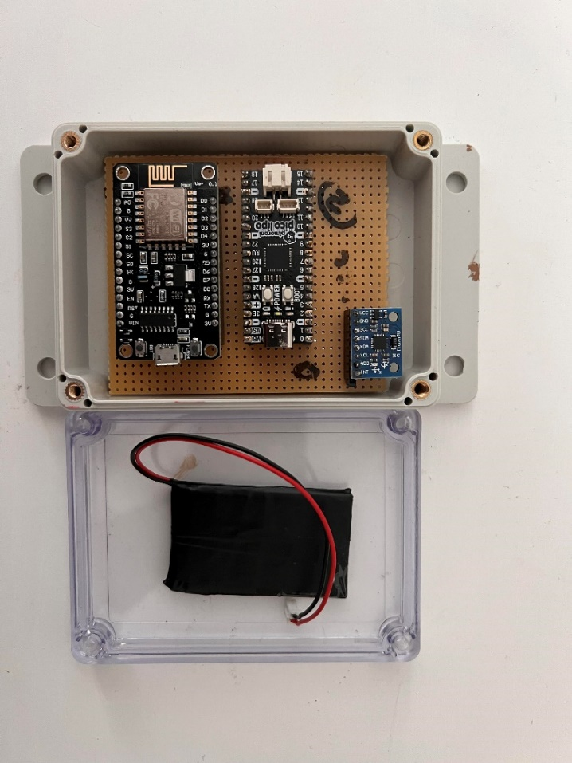
Phase 4 | Enclosure and Mounting
Height | Length | Breadth
6 cm | 17 cm | 8 cm

Slide 24
Learning Outcomes
Communicaiton Protocols – I2C | SPI
Building Core for Arduino IDE | GCC (LINUX) based compilation
ML Data Preprocessing
ML Algorithms
Testing Procedure | Software Development techniques
IOT
Power Management strategies.

Slide 25
Future Scope
Improvisation/Regularization of ML Model for better accuracy
Integration of low power communication protocol to notify Facility Managers(e.g. NB-IOT)
Implementation of Acceleration sensor with better interrupt generations (Tilt Motion)
Mounting the Device on the Garbage Can for real data and demonstration

Slide 26
Demo

Slide 27
Any Questions?

